Slide 1

HTML
HYPER TEXT MARKUP LANGUAGE
Reporter: M. SNEKAPRIYA

Slide 2

INTRO OF HTML TAGS..
An HTML tag is a particular word or letter enclosed by angle brackets, < and >. You utilize tags to build HTML components, such as sentences or links. The HTML code is read from top to bottom and left to right by a web browser when viewed on a computer screen. HTML documents and their characteristics are created and rendered using HTML tags.

Slide 3
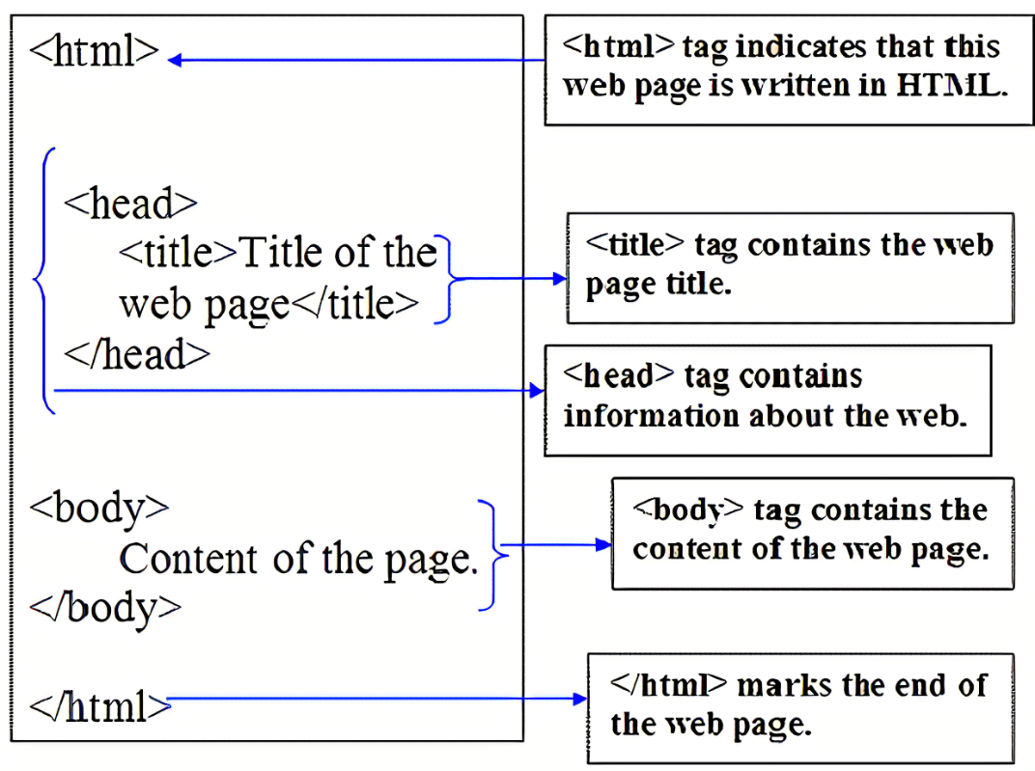
STRUCTURE OF AN HTML PROGRAM
<html>
<head>
<title>
Title of your document goes here
<title>
</head>
<body>
Your document goes here
</body>
</html>

Slide 4
1
BASIC TAGS IN HTML
2
CHARACTER FORMAT TAGS(CF)
About HTML
tags..
CONTENTS
3
OUTPUT TAGS
4
BLOCK TAGS AND OTHER TAGS

Slide 5
BASIC TAGS
01

Slide 6
1.BASIC TAGS
<html>
<heads>
<title>
01
It defines the html document.This element tells a browser that this is an HTML document.This tag is defined at the top of html file and end of file.
02
It defines information about the document.The head tag defines information about the document.The browser does not display the “head
information”
03
it defines the document title.Title tag defines the title of the document which appear in the title bar of the explorer window.

Slide 7
1.BASIC TAGS
<p>
<br>
<hr>
04
It defines a paragraph.
This tag is used for creating the paragraph in the web page.It is used
inside the body of file.
05
It inserts a single line break.The<br>tag to enter blank lines but not to separate paragraphs.the tag has no end tag.
06
The <hr> tag inserts a horizantal rule.The <hr>tags has no end ag.

Slide 8
CHARACTER FORMAT TAGS (CF TAGS)
02

Slide 9

CHARACTER FORMAT TAGS(CF TAGS)
These tags are used for the formatting of the text such as underline,bold,italic,
font,sie,colou of the text.
<b>tag - The <b>tag is used to make the text bold.
<i>tag - The tag displays the italic text.
<tt>tag - The tag displays the typewriter text.
<u>tag - The tag to displays the underlined text.
<em>tag - This tag displays the emphasized text.
<big>tag - This tag displays the big text.
<small>tag - This tag displays the small text.
<strong>tag - This tag displays the strong text.
<sub>tag - This tag displays the text in subscripted format.
<sup>tag - This tag displays the supersubscripted text.

Slide 10
OUTPUT TAGS
03

Slide 11
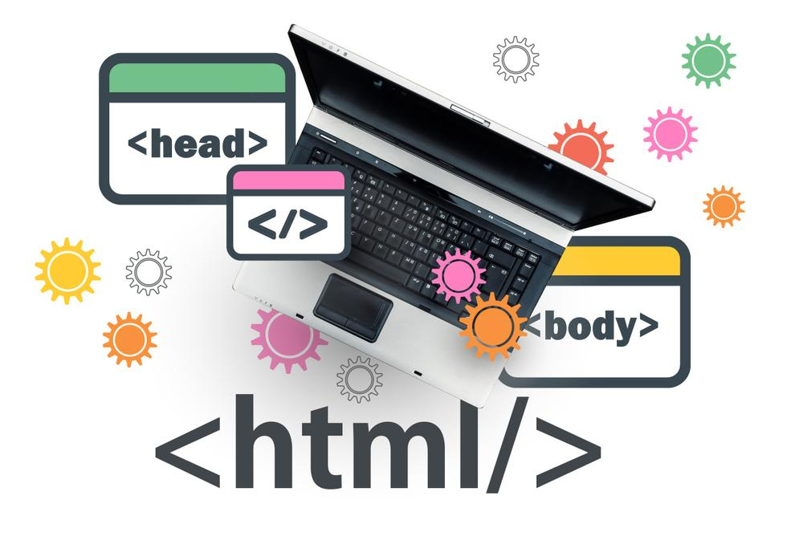
3.OUTPUT TAGS
<pre>....</pre> tag :
These tags are often used to display computer/programming code.
01
This is performed text.It preserves both spaces and line breaks.The pre tag is good for displaying computer code.
<code>...text...</code>tag :
02
This tag is also used to display the computer code.But butter you use<pre>tag.
<kbd>...keyboardinput..</kbd>
tag :
03
This tag displays the keyboard input.
<tt>..text..</tt>tag :
04
This tag displays the typewritter text.

Slide 12
4.BLOCK TAGS
1.<acronyms>..text...</acronyms>tag :
The tag defines the start of an acronym,like “www”.By marking up acronyms you can give useful information to browsers,spell checkers,translation systems and search engine indexers.
The title atribute can be used to show the full version of the expreesion when you are holding the mouse over the acronym(text).
2.<abbr>...text..</abbr> :
Indicades the abbrivated form, like”inc.”,”etc..”.By marking up abbrivations you can give useful information to browsers,spell checkers,translation systems and search-engine indexers.
3.<blackquote>...text...</blackquote> :
The <blackquote>tag defines the start of a long quotations.
4.<q>small text</q> :
The <q> tags defnes the start of a short quotations.

Slide 13
5.<centre>....</center> :
This tag centers its enclosed text horizontally.
6.<cite> :
This tag defines the citations.
7.<ins> :
This tag provide the facility of inserting the text in between the text.
8.<del> :
Defines text that has been deleted in a document.

Slide 14
OTHER TAGS
05

Slide 15
5.OTHER TAGS
1.The <style>tag :
The <style> tag defines the style in document.
2.The <div>tag :
The<div>tag defines a divisions / section in a document.
3.MarqueeText with<Marquee>tags :
This tag is used to get a moving text.

Slide 16
THANK YOU

